Slide 1


Civil Engineering Informatics
Intake:42
C-ALPHA

Slide 2




Team Members
Ahmed Owis
Aya Tharwat
Fatma Alaa
Wesam Khaled

Slide 3
Table Of Content
Introduction
1
2
Business overview
C-ALPHA
3
4
Project Description
Project Scope
Live Demo
5
6
Future Enhancement

Slide 4

1.Introduction:
1.1.Construction project management software
In the construction business, when you don't execute your plan well, things will slip through the cracks, literally! Watch your projects become a towering success using C-ALPHA Projects

Slide 5


1.2.Issues facing the construction industry
Web of dependencies:
You often find yourself trapped in trying to track and manage never-ending dependencies
Time is money:
You can't afford to postpone operations without huge expense overruns.
Unmet deadlines often mean unplanned expenditures.

Slide 6


1.2.Issues facing the construction industry
3. What? Who? When?
What's happening at the construction site right now?
Who is supposed to ship the material?
When is the meeting scheduled?
4. But he said so
Multiple people work on a single project.
Miscommunication can lead to serious flops when the right information isn't communicated to the right people at the right time.

Slide 7
2. Business overview
Saving Time
Easy to use
It has more Productivity rate to make time schedule.
It can reach the right work flow easily.
Free Open Source
Compatible
Available Online .
It is compatible with other softwares like Primavera P6.

Slide 8

3. C-ALPHA Scope:
3.1. Task Management
3.2. Time Schedule

Slide 9




3. C-ALPHA Scope cont..
3.3. Planned Budget Tracking Method
3.4. Resource Analysis &Allocation

Slide 10

C-Alpha

Slide 11
4.1. Used Technologies
4. Project Description:
Front-End
Back-End
Database
Third Parties
HTML
CSS
JS,JQuery,BOOTSTRAP
ASP.NET CORE
ASP.NET MVC
LinQ
Local SQL server DB
EF
DHTMLX for Main Gantt Chart.
Fusion Charts for cash flow and resource profile.
Any-chart library for Critical path Gantt chart.
ClosedXml

Slide 12
4.2. C-ALPHA Features
Scheduling
Resources
Activities as a gantt chart .
Relations between activities.
Lags.
Critical path.
Crashing (PERT).
Resource allocation.
Resources profile.
Export
Cash Flow
To Excel (Xls).
To Primavera(xml).
To PDF.
Cash Flow (Monthly- Daily).
Calender
Upload-Files
Assign Events & Meetings.
Attachment files as PDF,JPG & Excel.

Slide 13




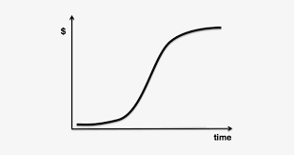

4.3. C-ALPHA Sequence
Project
Activities
Resources
Resource Profile
Cash flow

Slide 14
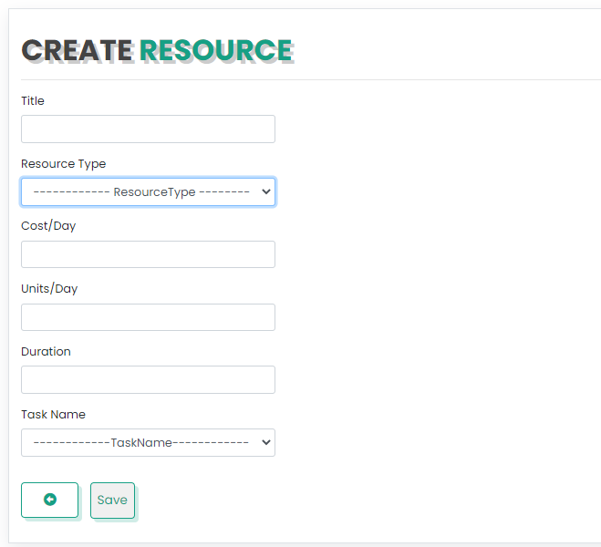

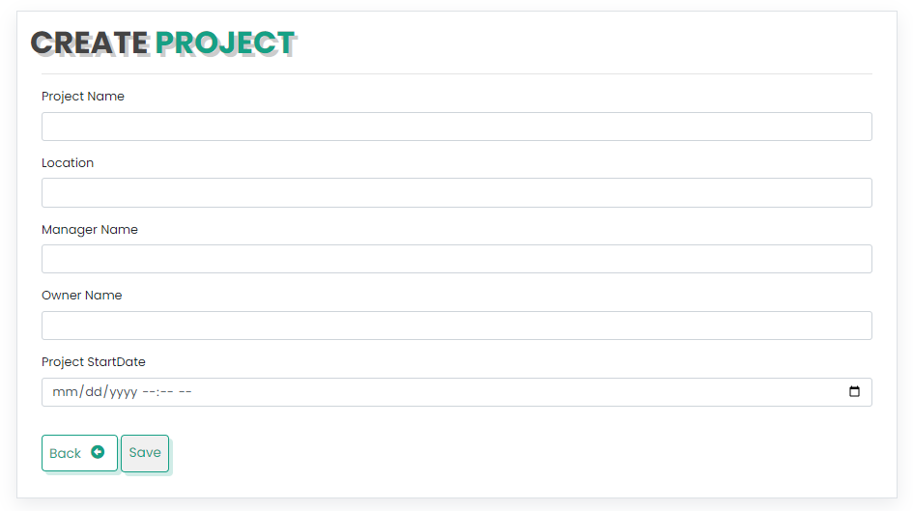
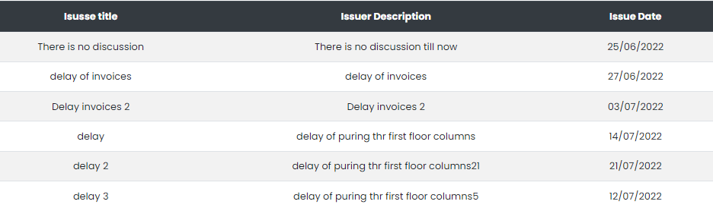
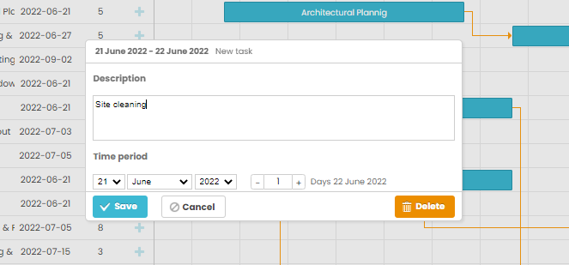
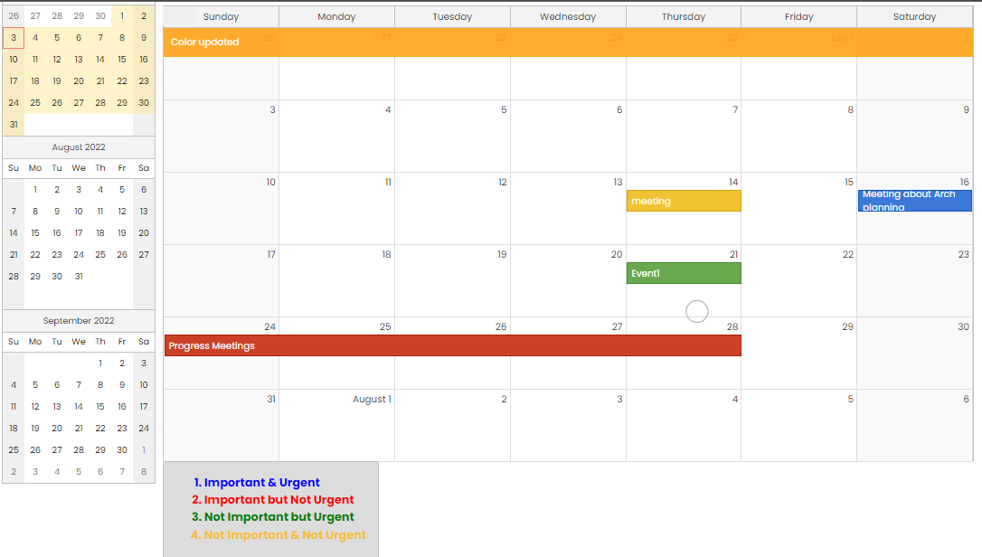
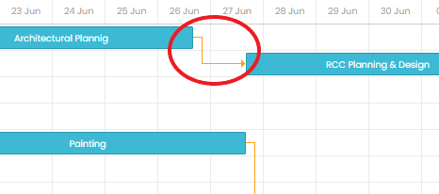
4.4. C-ALPHA Inputs
Resources
Project Information
Project Issues
Activities
Event
Relation Between Activities

Slide 15
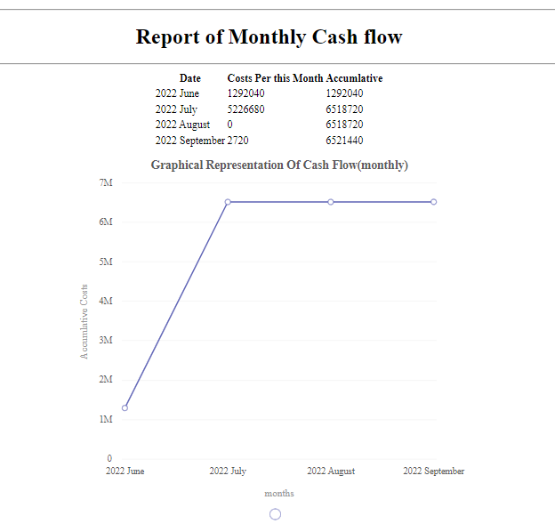
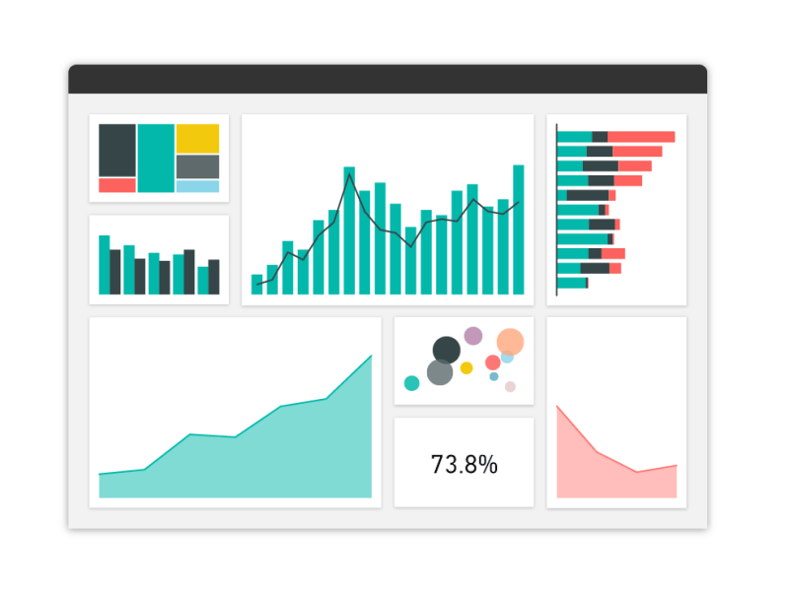
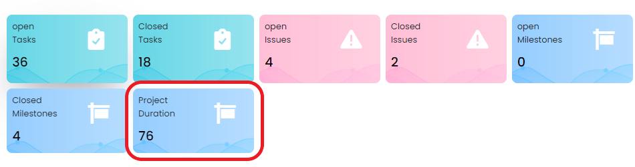
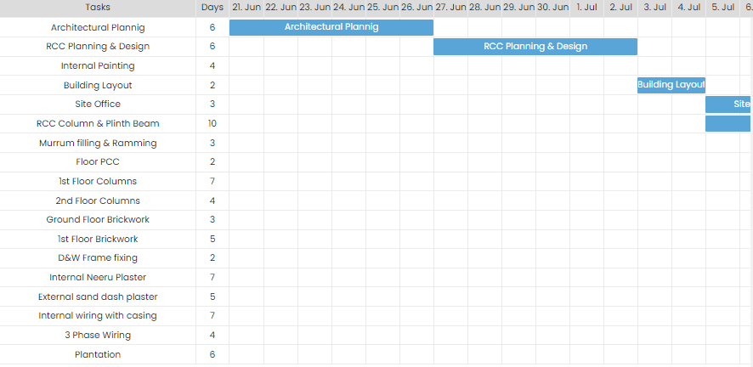
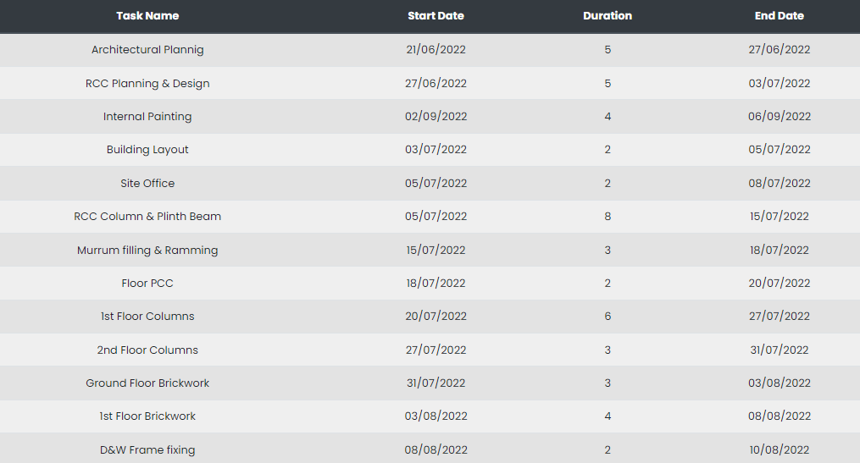
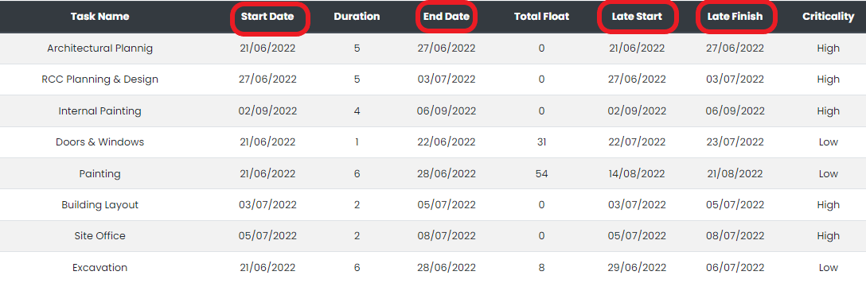
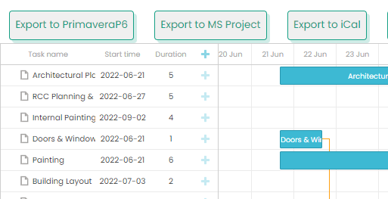
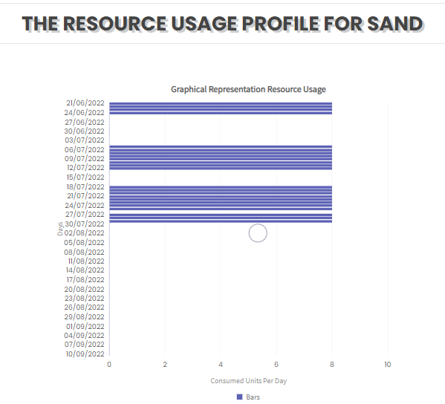
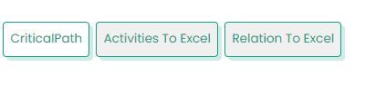
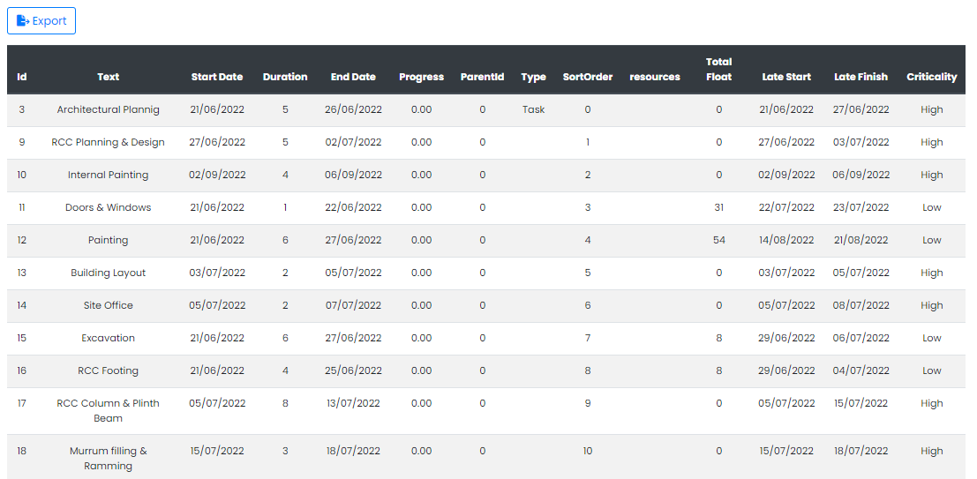
4.5. C-ALPHA Outputs
Reports
Project Duration
Critical Activities
Activities Start & End Dates
Exported files to other software
Resources Profile and Consumption rate

Slide 16

5. Live Demo

Slide 17
6. Future Work
Fit the Time Schedule with a specific limit in a specific Resource .
01
Resource Levelling
Collect the Actual Rates of work from executed Activities and update the time schedule.
02
Update Schedule
Time and Cost Risk Analysis with uncertainty calculations.
03
Risk Analysis
Mobile application can receive time schedule and make daily notification of daily work plan and required resources .
04
Mobile Application Version

Slide 18
6. Future Work Cont..
Fit the Time Schedule with a specific limit in a specific Resource .
05
Import files from Excel
Two case scenarios:
1- The role of the project manager to create the while project plan and edit through the tasks and assign roles to the engineers working on the project
2- Then each user would only have access to view the parts they are assigned to.
06
Assign tasks to users

Slide 19

Thank You!

